Slide 1
Lecture 8: Multivariate models
May 15, 2018
Learning objectives:
Implement and evaluate spatial factor analysis
Understand interpretation of additive covariance matrices

Slide 2
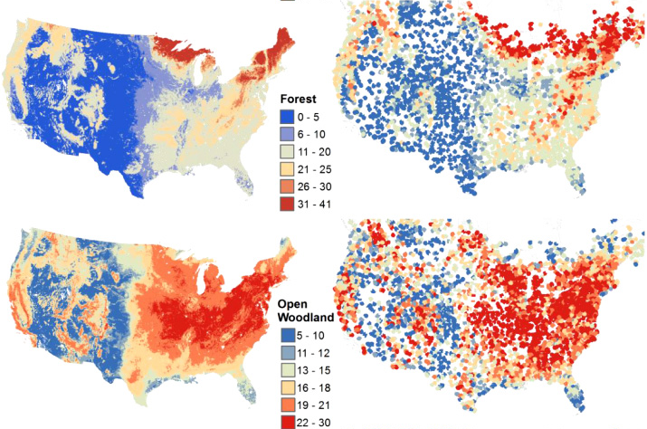
Species richness of North American birds from Breeding Bird Survey
Image: Goetz et al. 2014 Environ. Res. Lett.

Slide 3
Community distribution models
Why an interest in distributions?
Suggestive of environmental and biological drivers
Motivate subsequent models and research
Distribution maps are intuitive for many users
Framework for local and traditional knowledge
Distribution models are a playground
Explore climate, invasions, habitat restoration, …
Notes:
Explain why I want to do this! (motivates theory of environmental or biological drivers for distributions)

Slide 4
Community distribution models
Spatial ordination is useful for …
Quantifying shared information among species
Identifying species with similar range
Correlating species range with measured variables
Notes:
Predicting rare/undersampled species, bycatch etc.

Slide 5
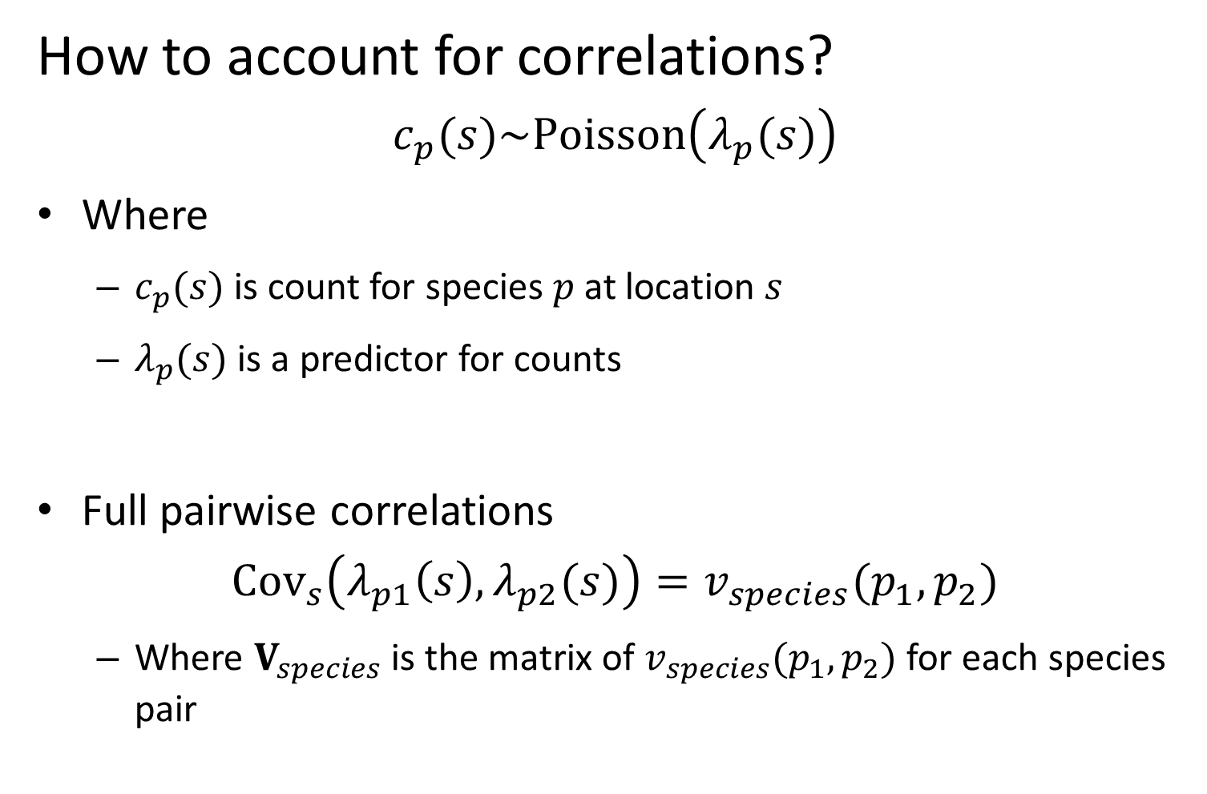
Community distribution models
How to account for correlations?
$$c_{p}(s)\sim Poisson\left(λ_{p}(s)\right)$$
Where
$c_{p}(s)$ is count for species $p$ at location $s$
$λ_{p}(s)$ is a predictor for counts
Full pairwise correlations
$${Cov}_{s}\left(λ_{p1}\left(s\right),λ_{p2}(s)\right)=v_{species}(p_{1},p_{2})$$
Where $V_{species}$ is the matrix of $v_{species}(p_{1},p_{2})$ for each species pair
Notes:
Predicting rare/undersampled species, bycatch etc.
Write function of s because its just a real value
Subscript for species because discrete

Slide 6
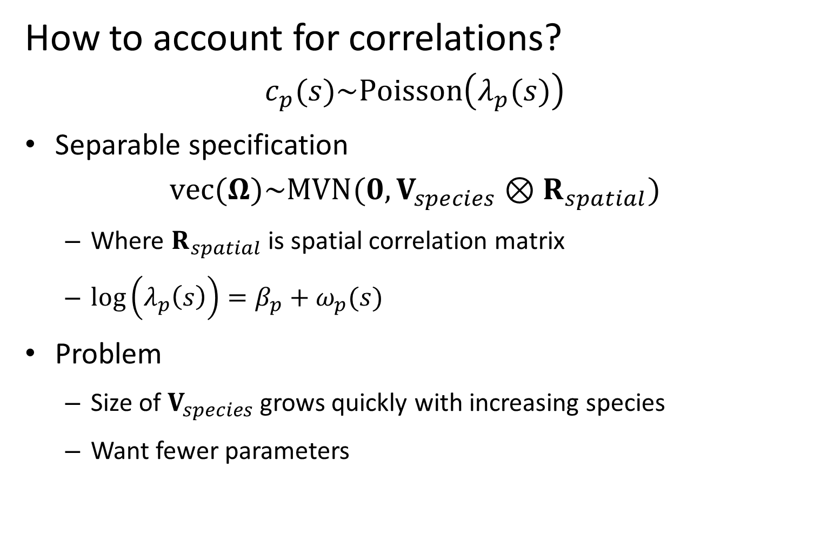
Community distribution models
How to account for correlations?
$$c_{p}(s)\sim Poisson\left(λ_{p}(s)\right)$$
Separable specification
$$vec(Ω)\sim MVN(0,V_{species}⊗R_{spatial})$$
Where $R_{spatial}$ is spatial correlation matrix
$\log\left(λ_{p}\left(s\right)\right)=β_{p}+ω_{p}(s)$
Problem
Size of $V_{species}$ grows quickly with increasing species
Want fewer parameters
Notes:
Predicting rare/undersampled species, bycatch etc.

Slide 7
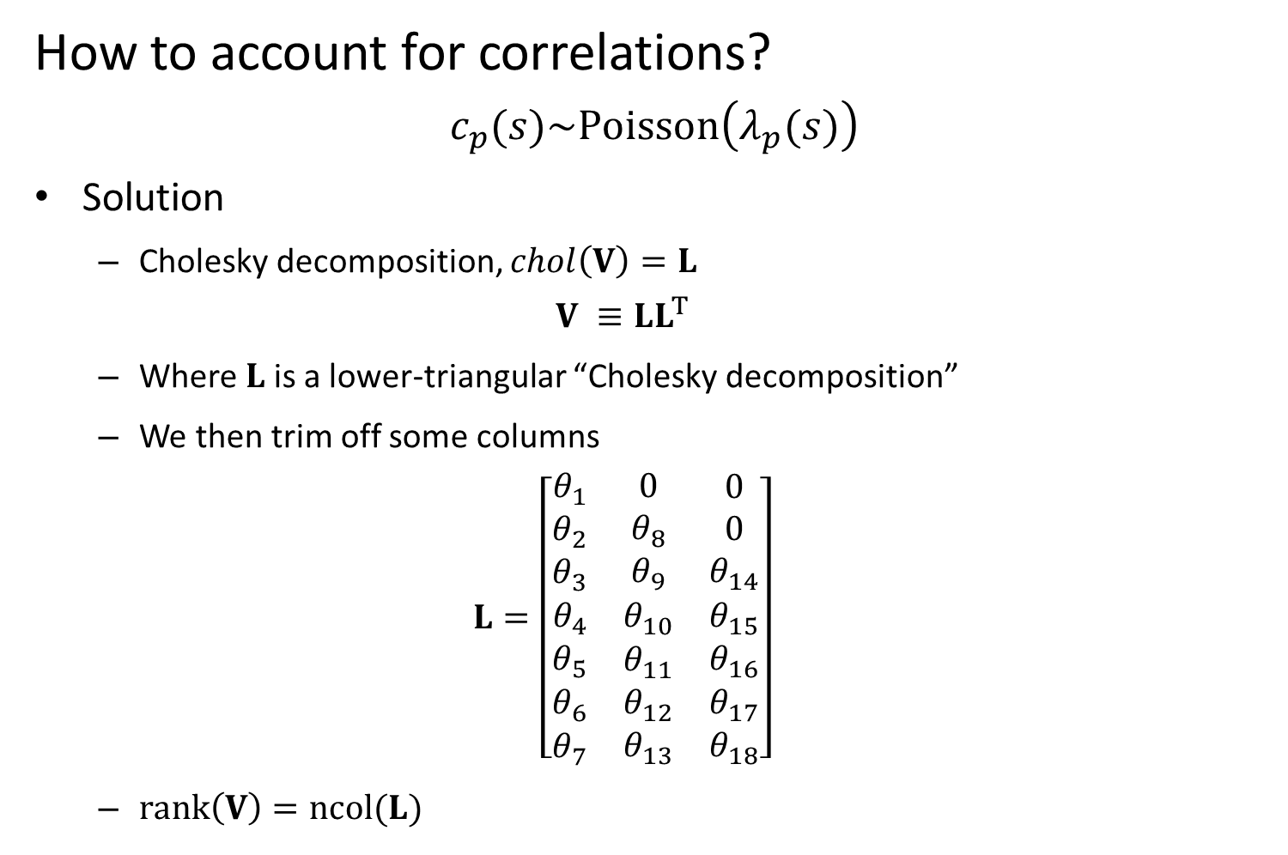
Community distribution models
How to account for correlations?
$$c_{p}(s)\sim Poisson\left(λ_{p}(s)\right)$$
Solution
Cholesky decomposition, $chol\left(V\right)=L$
$$V ≡LL^{T}$$
Where $L$ is a lower-triangular “Cholesky decomposition”
We then trim off some columns
$$L=\left[\begin{matrix}\begin{matrix}θ_{1} \\ θ_{2} \\ θ_{3}\end{matrix} & \begin{matrix}0 \\ θ_{8} \\ θ_{9}\end{matrix} & \begin{matrix}0 \\ 0 \\ θ_{14}\end{matrix} \\ θ_{4} & θ_{10} & θ_{15} \\ \begin{matrix}θ_{5} \\ θ_{6} \\ θ_{7}\end{matrix} & \begin{matrix}θ_{11} \\ θ_{12} \\ θ_{13}\end{matrix} & \begin{matrix}θ_{16} \\ θ_{17} \\ θ_{18}\end{matrix}\end{matrix}\right]$$
$rank\left(V\right)=ncol(L)$
Notes:
Predicting rare/undersampled species, bycatch etc.
Aka spatial factor analysis, bec;uase this si sthe same trick used In factor analysis

Slide 8
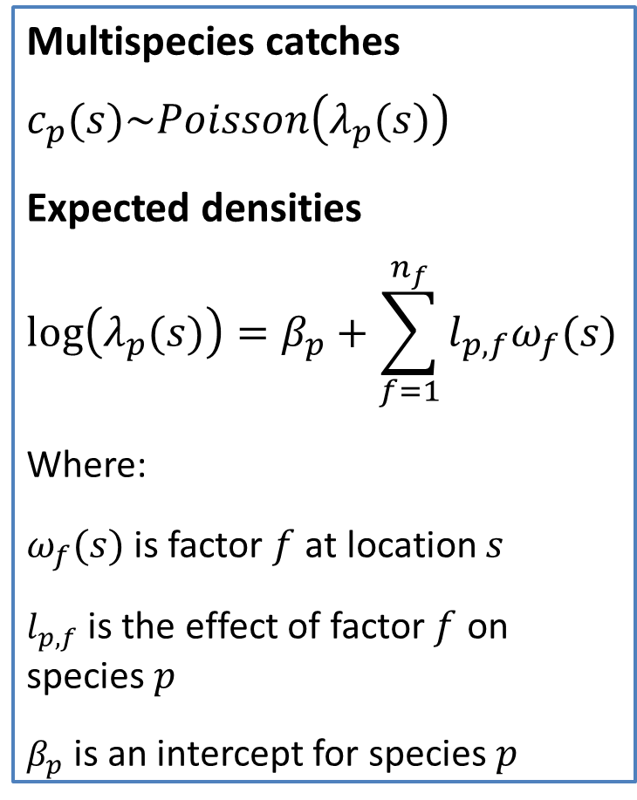
Community distribution models
Spatial factor analysis
Estimates “latent” maps for co-occurring species
Separates process and measurement error
Derived estimates of co-occurrence
Multispecies catches
$$c_{p}(s)\sim Poisson\left(λ_{p}(s)\right)$$
Expected densities
$$log⁡\left(λ_{p}(s)\right)=β_{p}+\sum_{f=1}^{n_{f}}{l_{p,f}ω_{f}(s)}$$
Where:
$ω_{f}(s)$ is factor $f$ at location $s$
$l_{p,f}$ is the effect of factor $f$ on species $p$
$β_{p}$ is an intercept for species $p$
Notes:
Animate in the math
Co-ocurrence from the loading matrix
L stands for lower of Cholesky, but that is same as the loadings matrix
Can have as many factors as there are species == full Cholesky
Omega is the factor and l is the loadings matrix
Factors are latent variables that explain the distribution

Slide 9
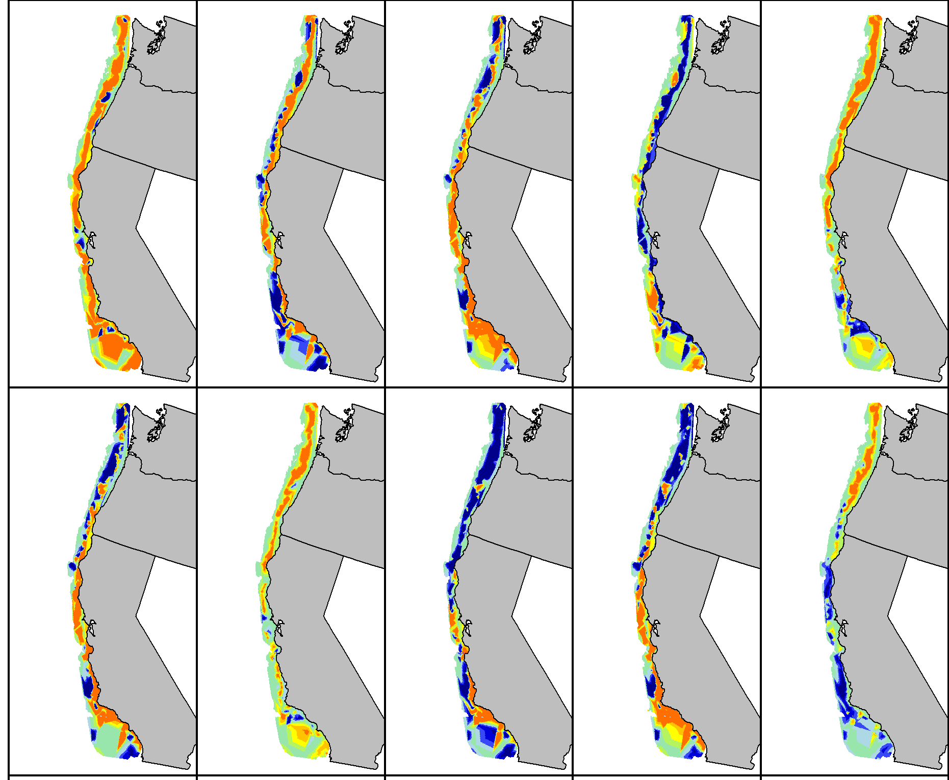
Predicted species distributions: High density / Medium density / Low density
Notes:
Explain colors (red: high);
Fix no-name panel!
Circle darkblotched and aurora (actually bring them forward in new slide)

Slide 10
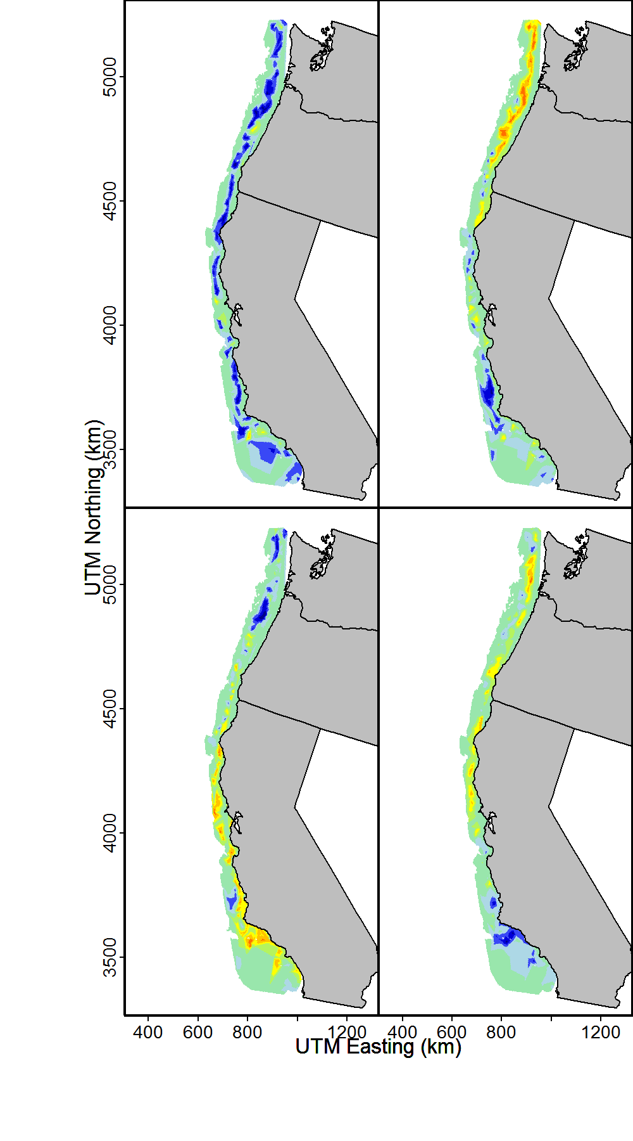
Community distribution models
Estimating latent factors
Estimated spatial factors: High density / Medium density / Low density
Notes:
Lots of shared information;
Talk about measured covariates; biogeographic breaks; searching for better descriptors
Hard to sort out the factors by eye

Slide 11
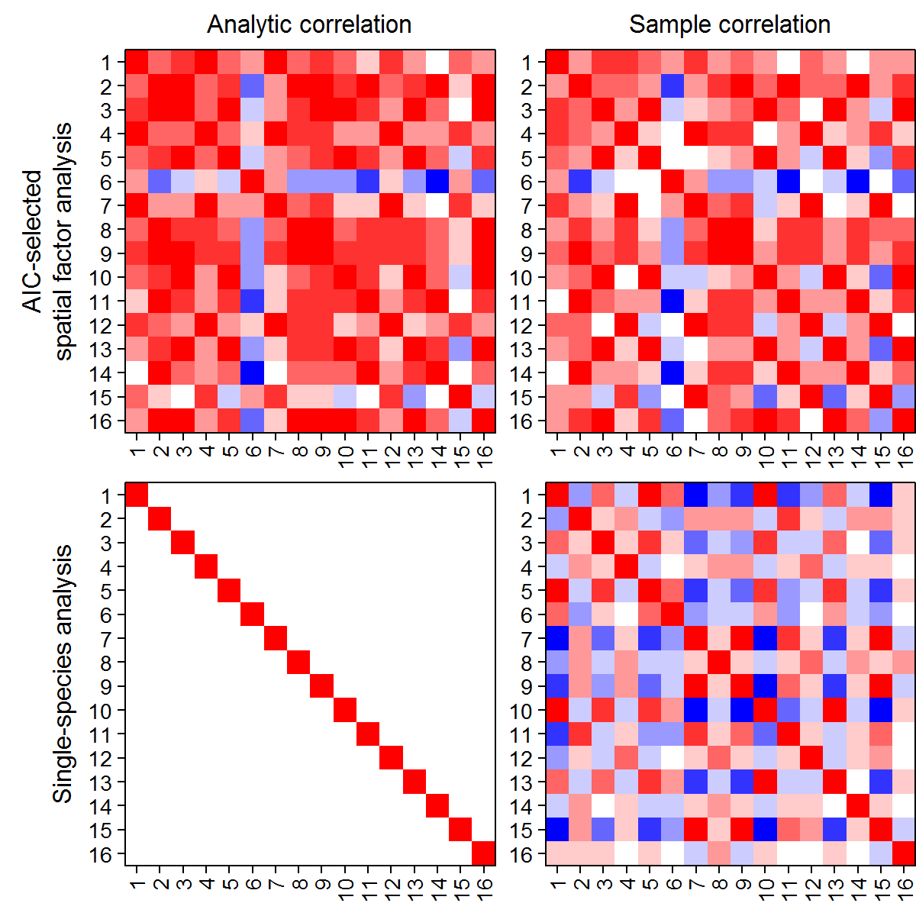
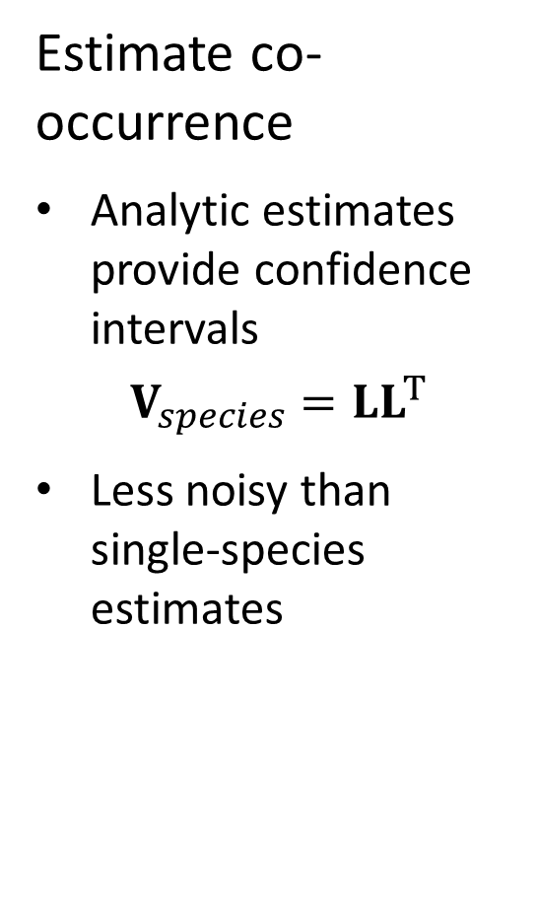
Community distribution models
Estimate co-occurrence
Analytic estimates provide confidence intervals
$$V_{species}=LL^{T}$$
Less noisy than single-species estimates
Correlation: 1 0 -1
Notes:
Animate these in; (explain colors immediately – ADD COLORS TO TEXT)
Consider dropping analytic column
Sample correlation prediction from the model
Bunch of single species models are implicitly assuming independence
Community patterns from single species distribution models—noisy, plus model assumptions != what you’re trying to test
If factors covary, you’ll get less noisy predictions by accounting for them together

Slide 12
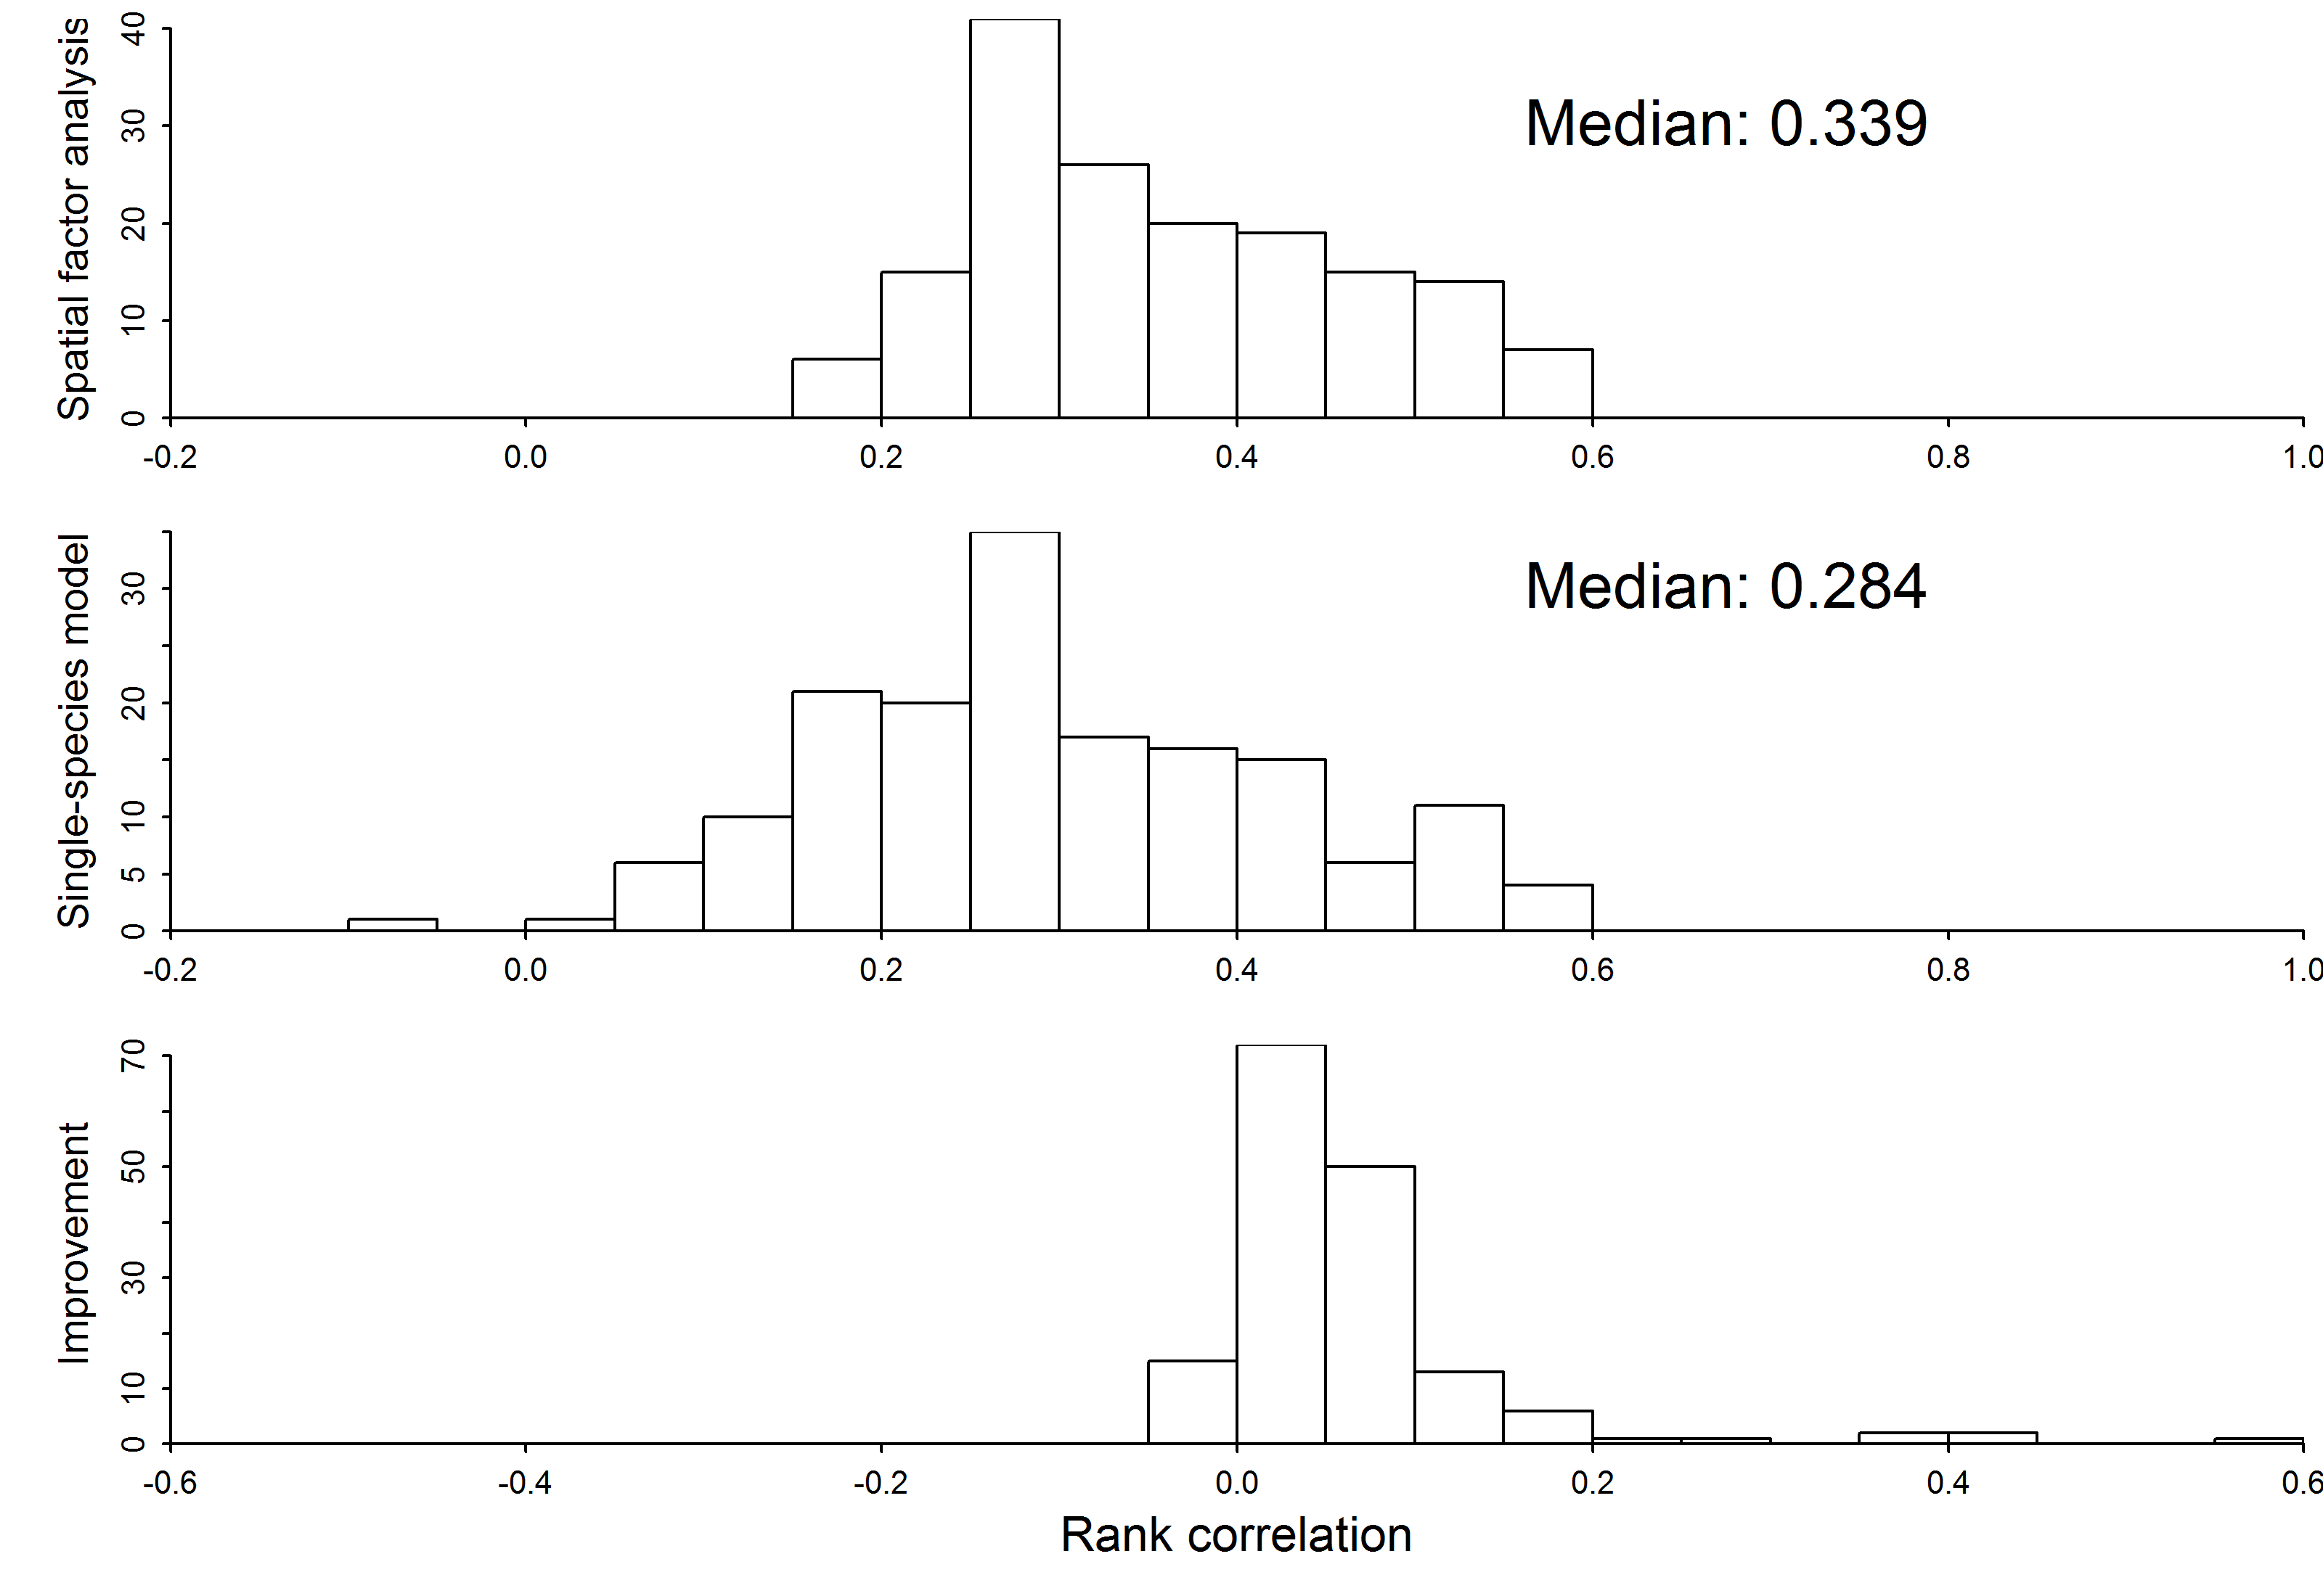
Community distribution models
Improves prediction
Spatial factor analysis
Single species models
Difference between methods
Bad Predictive accuracy Good
Notes:
Label y-axis
Bottom one; show line dividing single species and multispecies
Covariates on RHS—can’t have missing data
LHS—do it as a factor model! Can deal with missingness
Any downsides? Covariance matrix format assumes linear relationship, but maybe more clunky
Steins paradox—adding more species, you get worse shrinkage if the indices are unrelated
Or put a lot of species in and use the model to do ordination…which ones are similar

Slide 13
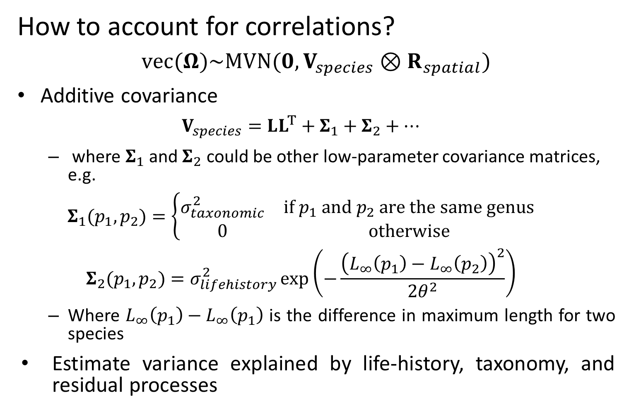
Community distribution models
How to account for correlations?
$$vec(Ω)\sim MVN(0,V_{species}⊗R_{spatial})$$
Additive covariance
$$V_{species}=LL^{T}+Σ_{1}+Σ_{2}+…$$
where $Σ_{1}$ and $Σ_{2}$ could be other low-parameter covariance matrices, e.g.
$$Σ_{1}(p_{1},p_{2})=\left\{\begin{matrix}σ_{taxonomic}^{2} & if p_{1} and p_{2} are the same genus \\ 0 & otherwise\end{matrix}\right.$$
$$Σ_{2}(p_{1},p_{2})=σ_{lifehistory}^{2}\exp\left(−\frac{{\left(L_{∞}\left(p_{1}\right)−L_{∞}\left(p_{2}\right)\right)}^{2}}{2θ^{2}}\right)$$
Where $L_{∞}\left(p_{1}\right)−L_{∞}\left(p_{1}\right)$ is the difference in maximum length for two species
Estimate variance explained by life-history, taxonomy, and residual processes
Notes:
Predicting rare/undersampled species, bycatch etc.
Model based variance partitioning
Gelman proposes as a way to do hypothesis testing—strength of evidence testing
Q: letting model estimate number of columns of L and all these other things…does it actually work? Identifiability??

Slide 14

Community distribution models
Expected densities
$$log⁡\left(λ_{p}(s)\right)=β_{p}+\sum_{f=1}^{n_{f}}{l_{p,f}ω_{f}(s)}$$
Is equivalent to:
$$log⁡\left(λ_{p}(s)\right)=β_{p}+\sum_{f=1}^{n_{f}}{l_{p,f}^{∗}ω_{f}^{∗}(s)}$$
Where
$$L^{∗}=LH$$
$$Ω^{∗}=H^{−1}Ω$$
and where $H$ is a rotation matrix
Notes:
Rotations matrix H
Replace l and w with some rotations of them…can see that H just drops out
Why would we do this?
L is lower triangle, so estimate the whole thing, not identifiable
Because it’s rank reduced by 3 (in the example, so it can’t be estimated)
Rotate L to the values of loadings are nonzero

Slide 15
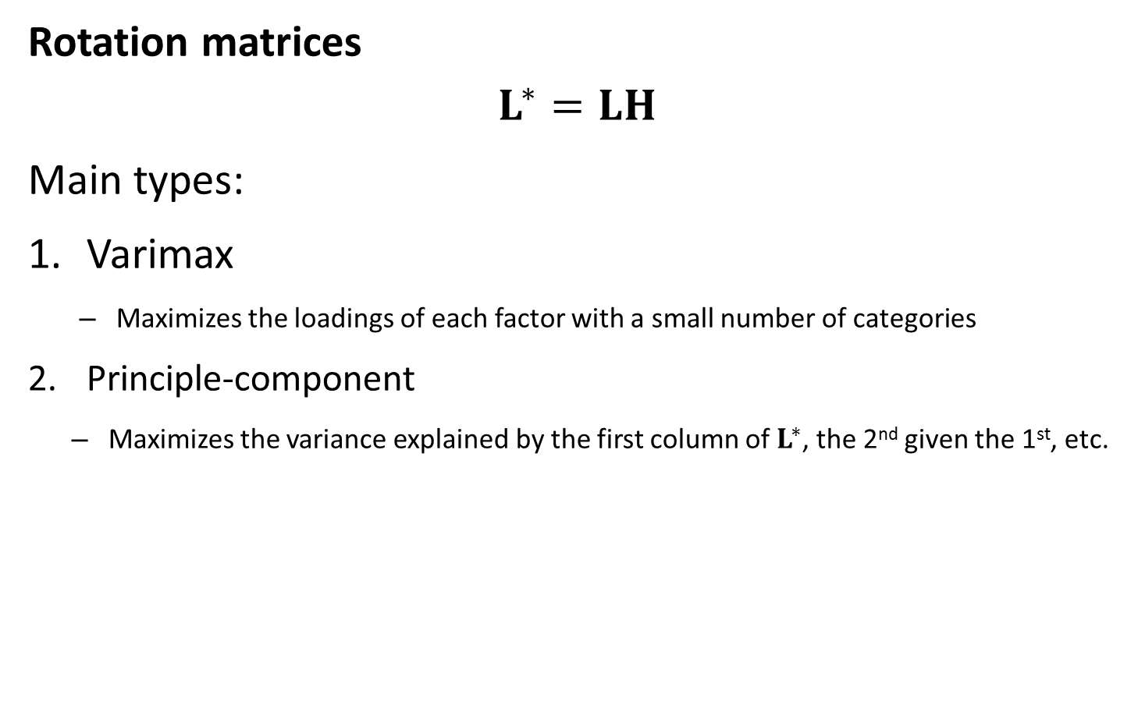
Community distribution models
Rotation matrices
$$L^{∗}=LH$$
Main types:
Varimax
Maximizes the loadings of each factor with a small number of categories
Principle-component
Maximizes the variance explained by the first column of $L^{∗}$, the 2nd given the 1st, etc.
Notes:
Improves the visualization of the model and our interpretation of the loadings and factors
Varimax—interpret factor 1 is associated with splitnose and factor 2 is darkblotch (core species for a each category) by max sum sq elements of L for species
Jim prefers PC approach. Mimic PCA so first factor explains the most variance and so on. Max sum sq element of first column, then second, etc.
Way of max some function L to ease biological interpretation
Rotation matrix is *-1 relative to true
Just backwards?

Slide 16
Community distribution models
Factor analysis
Warton, D.I., Blanchet, F.G., O’Hara, R.B., Ovaskainen, O., Taskinen, S., Walker, S.C., Hui, F.K., 2015. So Many Variables: Joint Modeling in Community Ecology. Trends Ecol. Evol.
Spatial factor analysis
Thorson, J.T., Scheuerell, M.D., Shelton, A.O., See, K.E., Skaug, H.J., Kristensen, K., 2015. Spatial factor analysis: a new tool for estimating joint species distributions and correlations in species range. Methods Ecol. Evol. 6, 627–637. doi:10.1111/2041-210X.12359
Spatial dynamic factor analysis
Thorson, J.T., Ianelli, J.N., Larsen, E.A., Ries, L., Scheuerell, M.D., Szuwalski, C., and Zipkin, E.F. 2016. Joint dynamic species distribution models: a tool for community ordination and spatio-temporal monitoring. Glob. Ecol. Biogeogr. 25(9): 1144–1158. doi:10.1111/geb.12464.
Dynamic factor analysis
Zuur, A.F., Tuck, I.D., Bailey, N., 2003. Dynamic factor analysis to estimate common trends in fisheries time series. Can. J. Fish. Aquat. Sci. 60, 542–552. doi:10.1139/f03-030

